Slide 1
Analysing Data from histograms
EQ – How do we analyse data from histograms?
Miss L
Year 8

Slide 2
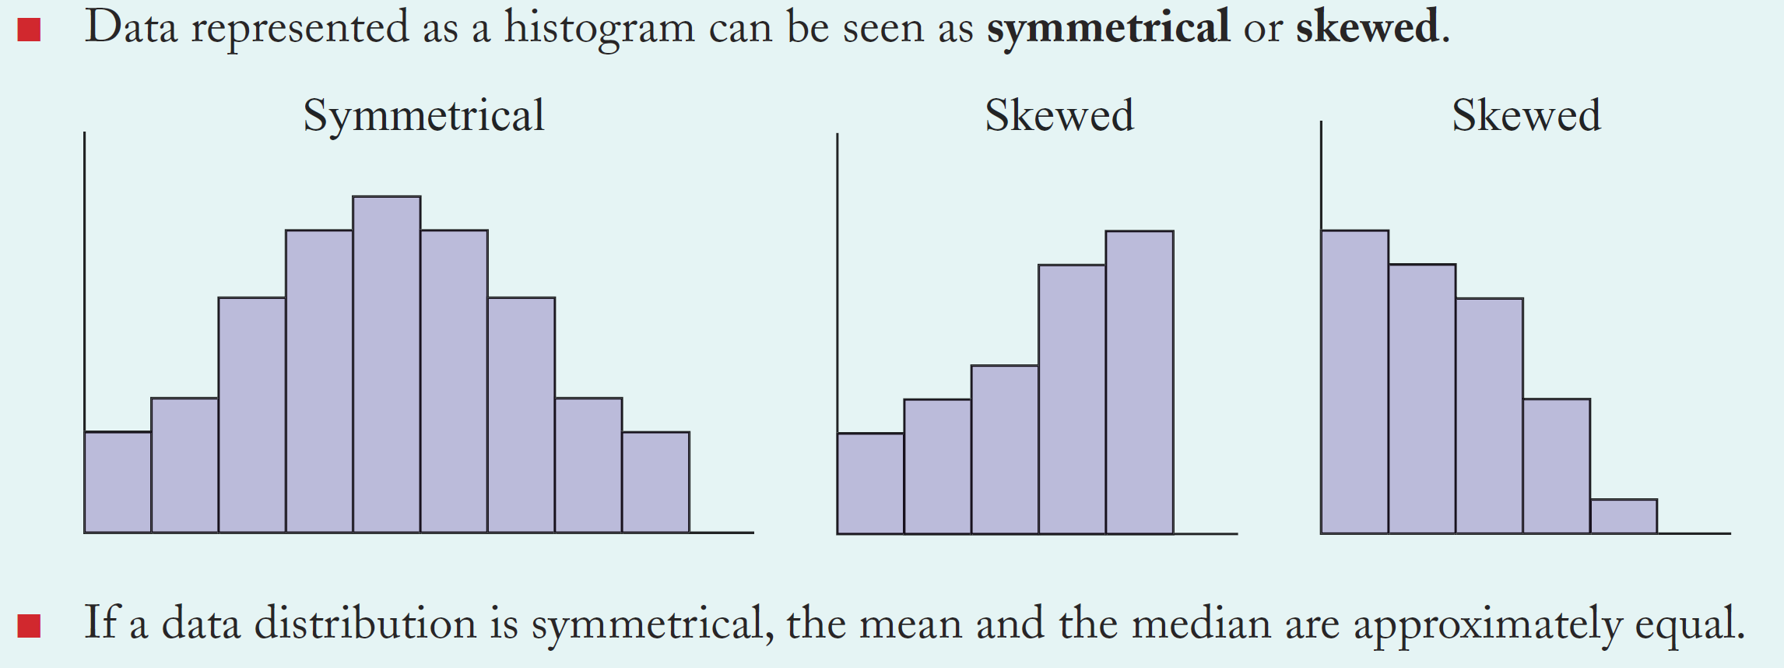
24
7
30
Analysing Data with histograms
Date
EQ – How do we analyse data from histograms?
How do we analyse a graph?

Slide 3
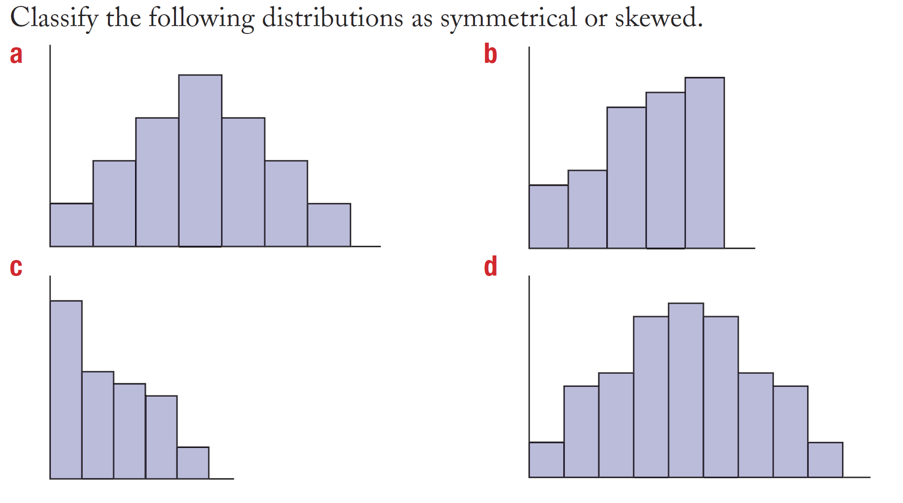
Practice

Slide 4
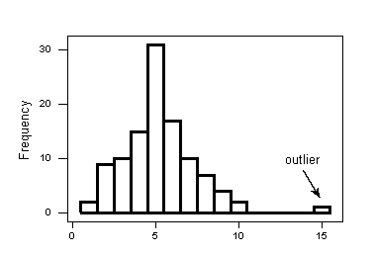
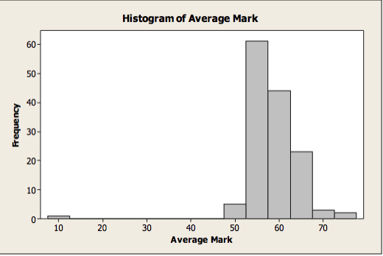
Histograms with outliers
One bar will be very far away

Slide 5


Slide 6
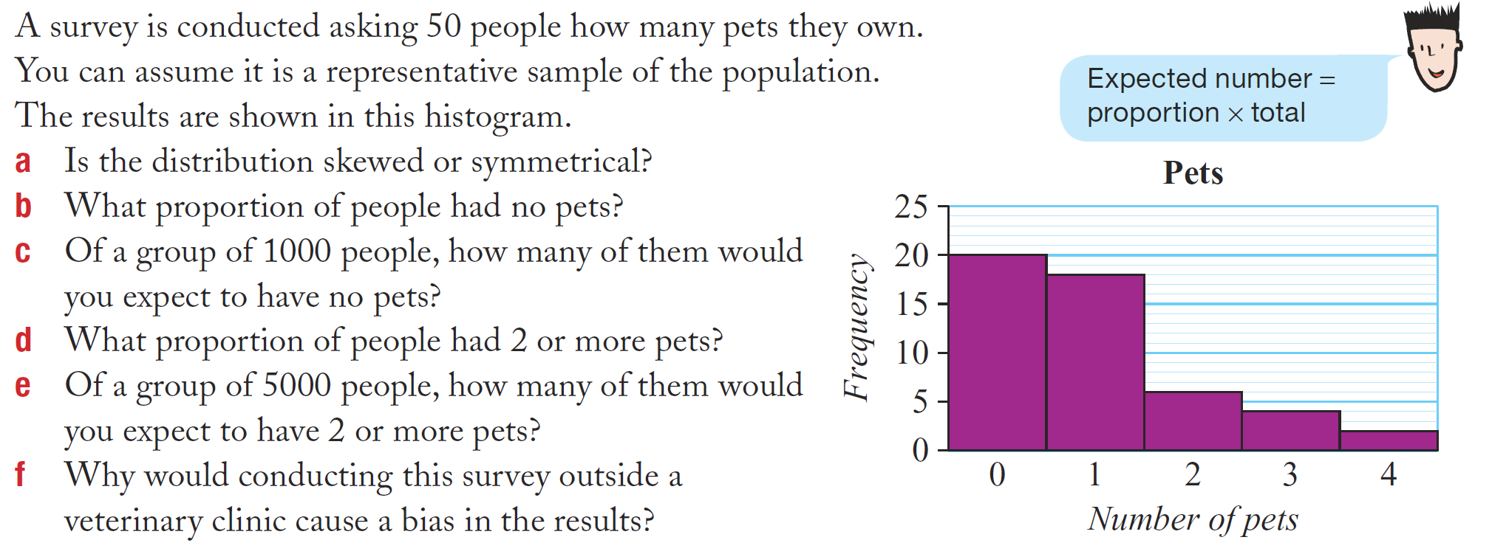
Task

Slide 7
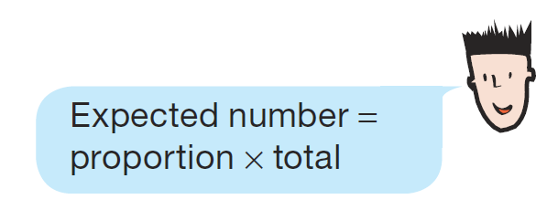
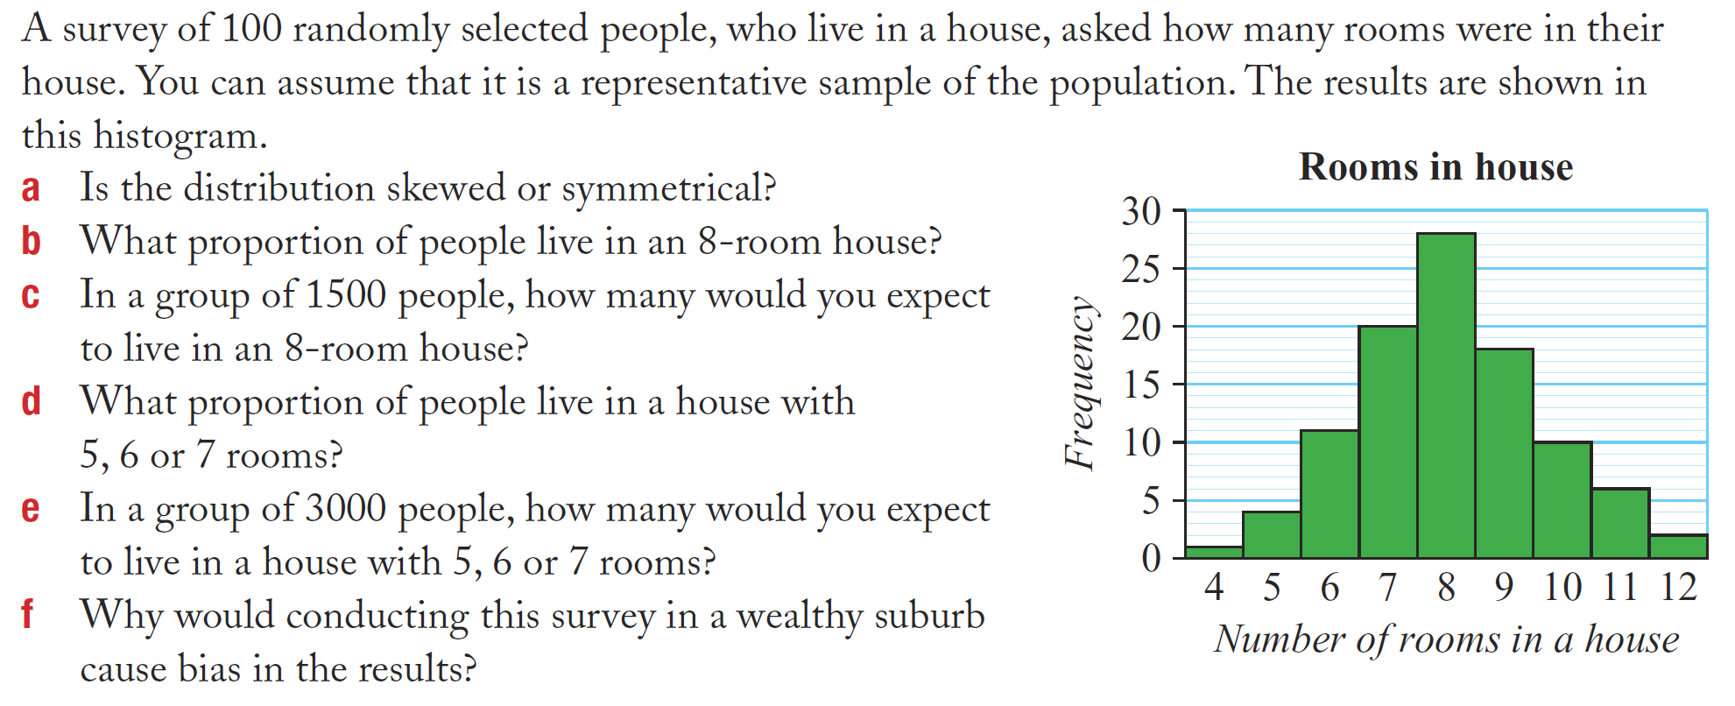
Task

Slide 8
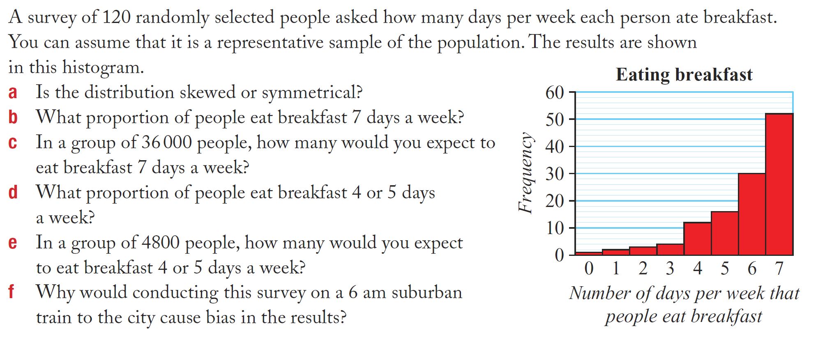
Task

